Slide 1



Enabling Active Learning for Real-Time Activity Recognition
Tianyi Wu
August 30, 2016
Department of Electrical Engineering, Xi’An Jiaotong University
Mentor: Dr. Majid Sarrafzadeh
Supervisor : Dr. Christine King
Anahita Hosseini
Department of Computer Science, UCLA

Slide 2

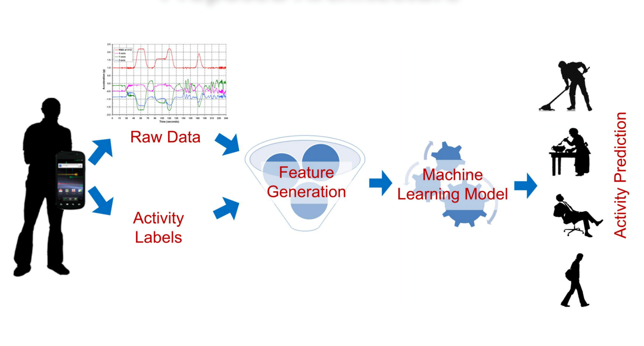
Background
Background
motivation
method
results
evaluation
Activity Recognition
Labeling cost is high
Simple and Complex Activity Recognition Through Smart Phones, Stefan Dernbach, 2012
Notes:
Activity recogntion, as a artificial intelligence task in Computer Vision, has been made easy from sensor data. It is a traditional Classification Task:
High accuracy
Datasets dependency
Unable to recognize new activities
Health, young reporting the physical condition

Slide 3
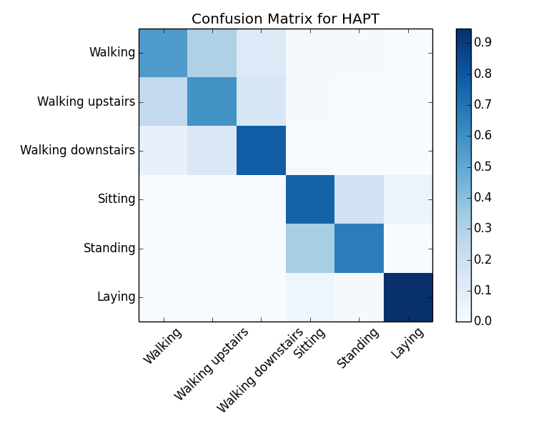
Dataset Analysis
Background
Background
motivation
method
results
Evaluation
Dataset | Users | Class Types | Frequency（Hz） | Sensor Location
HAPT | 30 | 6 | 50 | Waist
Sliding window in 2s, Low Pass Filtering at 20Hz
Feature extraction: 38 features
mean, standard deviation, variance, min, max, skewness, kurtosis, energy
Correlation between x, y, z, mean

Slide 4
Motivation
background
motivation
method
results
evaluation
Personalized Activity Recognition System
Optimize performance in streaming environment
Require few labeling efforts for offline training
Sequentially adapt to new changes
Allow for user annotation for uncertain classes
query for most information with least labels
Minimize future classification error
Active Learning Objectives
Notes:
Active learning can be

Slide 5
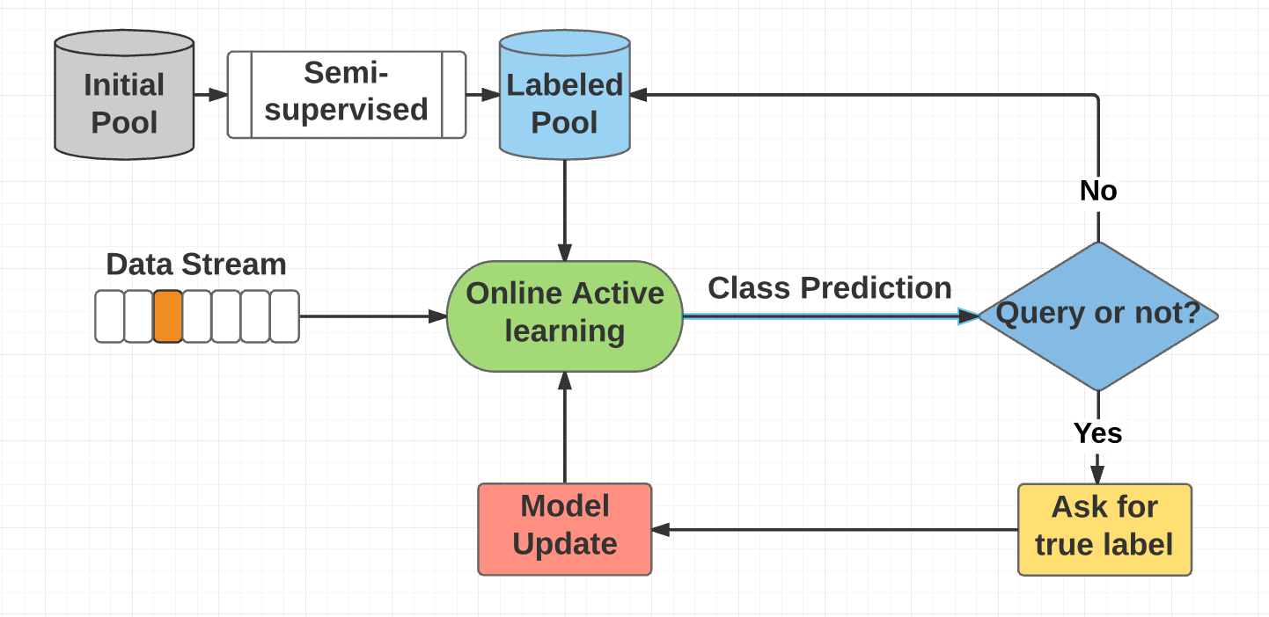
Method
Background
motivation
method
results
Evaluation
Stream-based Active Learning System Design

Slide 6
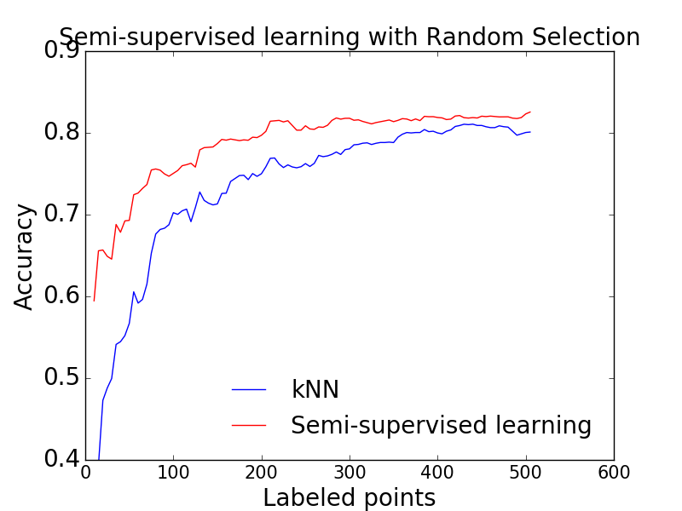
Method
Background
motivation
method
results
Evaluation
Details for Algorithm Design
Graph-based semi-supervised learning
enlarge labeled size
Random forest pair-wise similarity measurement
label prediction
model update

Slide 7
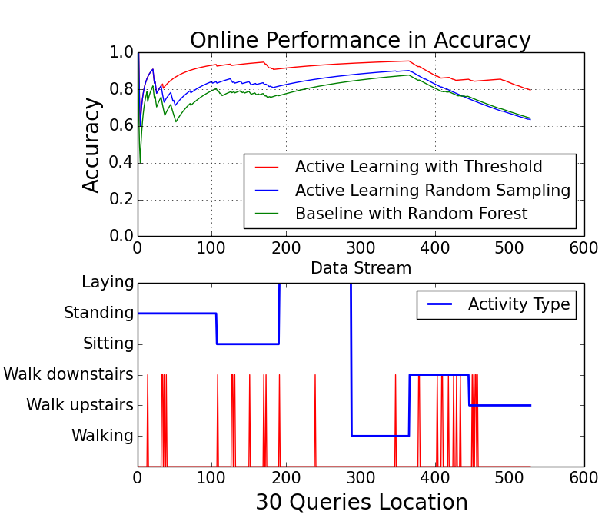
Results
Background
motivation
method
results
Evaluation
Simulation for one User

Slide 8
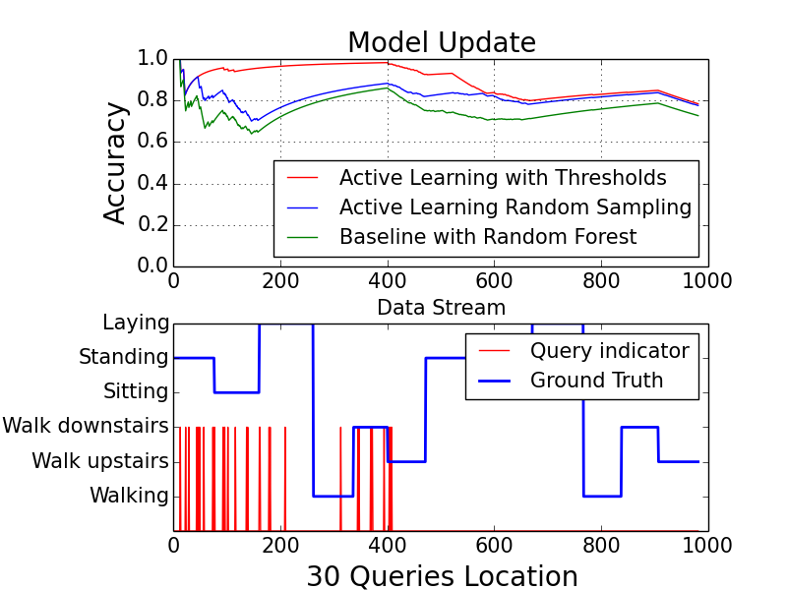
Results
Background
motivation
method
results
Evaluation
Simulation over two users in a row
New User

Slide 9
Accuracy Gain in 30 queries
Evaluation
Background
motivation
method
results
Evaluation
The active learning model required maximum 30 queries for 1 user
Random Forest | Random Selection | Active Model | SSL Labeled Rate | Accuracy Improvement
0.6725 | 0.651 | 0.702 | 50:50 | 3.0%
0.664 | 0.650 | 0.766 | 50:100 | 10.2%
0.637 | 0.626 | 0.760 | 50:150 | 12.3%
0.6274 | 0.660 | 0.724 | 50:200 | 9.7%

Slide 10
Time Complexity Analysis
Evaluation
Background
motivation
method
results
Evaluation
New data is preprocessed in 2 sec sliding window
Represented in 38 dimension feature vector
Training Samples | Offline Phase(s) | Online Phase(s) | Update Phase(s)
50 | 0.099 | 0.3320 | 0.06977
100 | 0.111 | 0.5267 | 0.05824
150 | 0.138 | 0.5847 | 0.1081
200 | 0.145 | 0.596 | 0.2170

Slide 11
Active Learning Query Heuristics
Evaluation
Background
motivation
method
results
Evaluation
Query threshold design
Max probability<0.2 , Time similarity<0.8
Objective function
loss function, query budget
Query Distribution over time
Activity segmentation
Notes:
begin in dense areas and move on to sparse location.

Slide 12



Background
motivation
method
results
Evaluation
Acknowledgements
This study was funded by the National Institute of the Biomedical Imaging and Bioengineering (NIBIB) Los Angeles Pediatric Research using Integrated Sensor Monitoring Systems (PRISMS) Center: The Biomedical REAl-Time Health Evaluation (BREATHE) Platform, NIH/NIBIB U54 award no. EB022002.
This study was funded by the National Institute of the Biomedical Imaging and Bioengineering (NIBIB) Los Angeles Pediatric Research using Integrated Sensor Monitoring Systems (PRISMS) Center: The Biomedical REAl-Time Health Evaluation (BREATHE) Platform, NIH/NIBIB U54 award no. EB022002.
This study was funded by the National Institute of the Biomedical Imaging and Bioengineering (NIBIB) Los Angeles Pediatric Research using Integrated Sensor Monitoring Systems (PRISMS) Center: The Biomedical REAl-Time Health Evaluation (BREATHE) Platform, NIH/NIBIB U54 award no. EB022002.

Slide 13
Background
motivation
method
results
Evaluation
Reference
[1] Dwarikanath Mahapatraa. (2016). Active learning based segmentation of Crohns disease from abdominal MRI. Computer methods and programs in biomedicine, 28 ,75-85
[2] H M Sajjad Hossain. (2016) .Active Learning Enabled Activity Recognition. IEEE International Conference on Pervasive Computing and Communications, 978-1-4673-8779-8/16
[3] Huazhong Ning. (2010). Incremental Spectral Clustering By Efficiently Updating The Eigen-System , Pattern Recognition ,43,113 -127
[4] Mohamed-Rafik Bouguelia. (2016). An adaptive streaming active learning strategy based on instance weighting, Pattern Recognition Letters ,70 38–44
[5] N.C. Krishnan, D.J. Cook. (2014). Activity recognition on streaming sensor data,
Pervasive Mob. Comput. 10 (Feb),138–154.
[6] Tudor Miu, Paolo Missier ,Paolo Missier. (2015).Bootstrapping Personalised Human Activity
Recognition Models Using Online Active Learning, IEEE International Conference on Computer and Information Technology , 978-1-5090-0154-5/15
[7] Sicheng Xiong. (2015). Active Learning of Constraints for Semi-Supervised Clustering, IEEE Transactions On Knowledge and Data Engineering, VOL. 26, NO. 1,43-54
[8] Davide Anguita, Alessandro Ghio, Luca Oneto, Xavier Parra and Jorge L. Reyes-Ortiz. (2013).A Public Domain Dataset for Human Activity Recognition Using Smartphones. 21th European Symposium on Artificial Neural Networks, Computational Intelligence and Machine Learning, ESANN. 24-26

Slide 14
Q&A
Background
motivation
method
results
Evaluation

Slide 15
Active Learning in streaming environment
Supplimentary
Background
motivation
method
results
Evaluation
1. Offline Learning Model
Graph-based semi-supervised Label Propagation
Construct windows as node, similarity matrix as weights
A small pool of labeled data with large unlabeled instances
2. Online Active Learning Model
Pair-wise similarity check with representative points
Disagreement for querying
Distance measurement
Update in batch mode

Slide 16
Machine learning accuracy
Background
Background
motivation
method
results
Evaluation

